Slide 1
Digital portfolio
STUDENT NAME : VISWANATH.S
REGISTER NO&NMID :35524U09045 & F57EC71DC17398093954A7AF1A13C3DA
DEPARTMENT :BCA-II
COLLEGE: COLLEGE/UNIVERSITY: GOVERNMENT ARTS AND SCIENCE COLLEGE TIRUPATTUR / THIRUVALLUVAR UNIVERSITY

Slide 2
Smart Digital Portfolio System
Project Title:

Slide 3


Agenda:
1. Problem Statement
2. Project Overview
3. End Users
4. Tools & Technologies
5. Portfolio Design & Layout
6. Features & Functionality
7. Results & Screenshots
8. Conclusion
9. GitHub Link
Agenda:
1. Problem Statement
2. Project Overview
3. End Users
4. Tools & Technologies
5. Portfolio Design & Layout
6. Features & Functionality
7. Results & Screenshots
8. Conclusion
9. GitHub Link

Slide 4

- Students often struggle to showcase skills, projects, and achievements effectively.
- Lack of a centralized, professional portfolio limits visibility.
- Manual processes reduce opportunities for career growth.
Problem Statement:

Slide 5

- A Digital Portfolio System to organize and present student achievements.
- Provides a professional and modern platform for students.
- Enables easy sharing with recruiters, faculty, and peers.
Project Overview:

Slide 6

- Students: To showcase skills, projects, achievements.
- Faculty: To review and validate student work.
- Recruiters/Companies: To access candidate portfolios.
End Users:

Slide 7

- Frontend: HTML, CSS, JavaScript, React.js
- Backend: Node.js / Python (Django/Flask)
- Database: MySQL / MongoDB
- Version Control: GitHub
- Design Tools: Figma / Canva
Tools & Technologies:

Slide 8
Portfolio Design & Layout:
- Modern UI/UX with responsive design.
- Sections: About Me, Education, Skills, Projects, Certifications, Contact.
- Easy navigation with interactive elements.
Portfolio Design & Layout:
- Modern UI/UX with responsive design.
- Sections: About Me, Education, Skills, Projects, Certifications, Contact.
- Easy navigation with interactive elements.

Slide 9
- Secure Login/Authentication.
- Upload & manage documents/certificates.
- Showcase projects with images/videos.
- Integration with GitHub & LinkedIn.
- Downloadable Resume in PDF format.
Features & Functionality:

Slide 10

- Demo screenshots of portfolio homepage, project section, and resume export.
- Highlighted student projects and achievements.
Results & Screenshots:
Results & Screenshots:
- Demo screenshots of portfolio homepage, project section, and resume export.
- Highlighted student projects and achievements.
Results & Screenshots:
- Demo screenshots of portfolio homepage, project section, and resume export.
- Highlighted student projects and achievements.

Slide 11
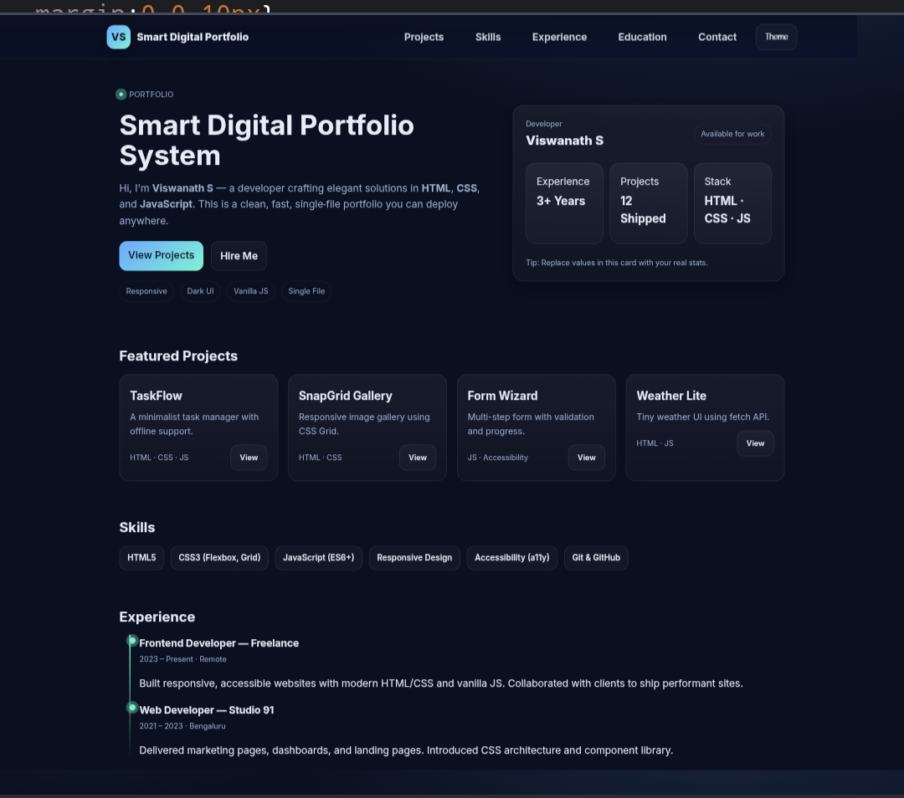
RESULT SCREENSHOT

Slide 12
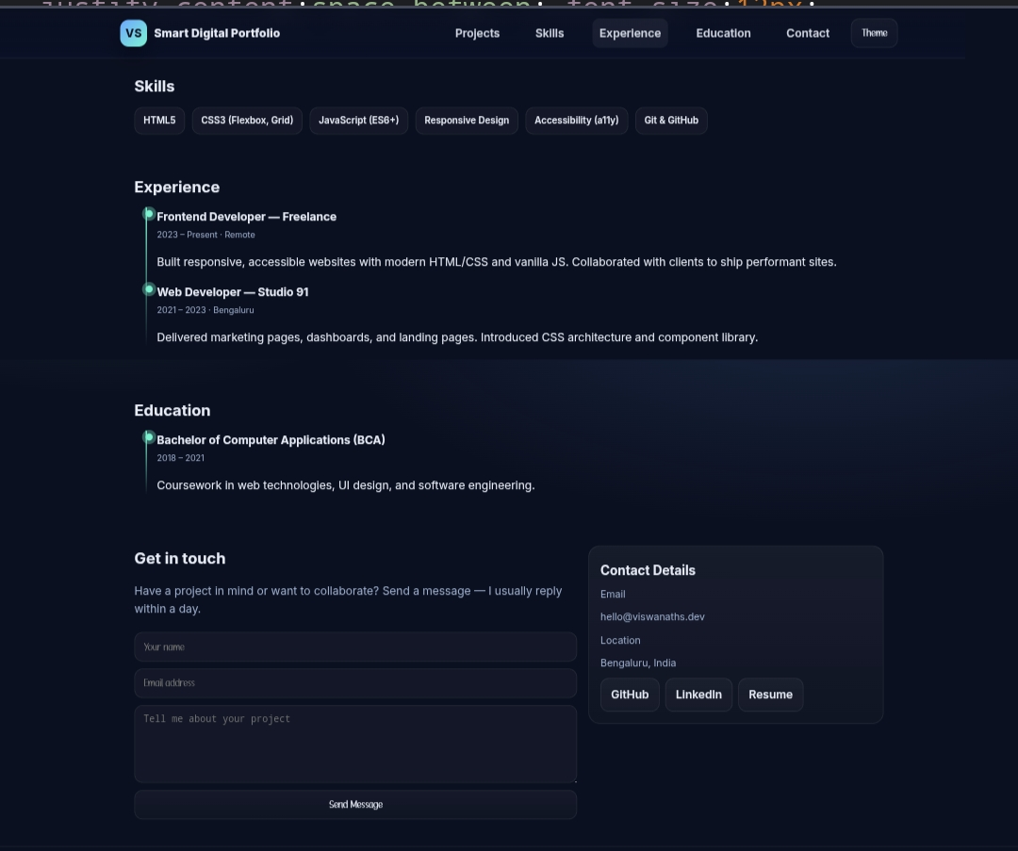
RESULT SCREENSHOT

Slide 13
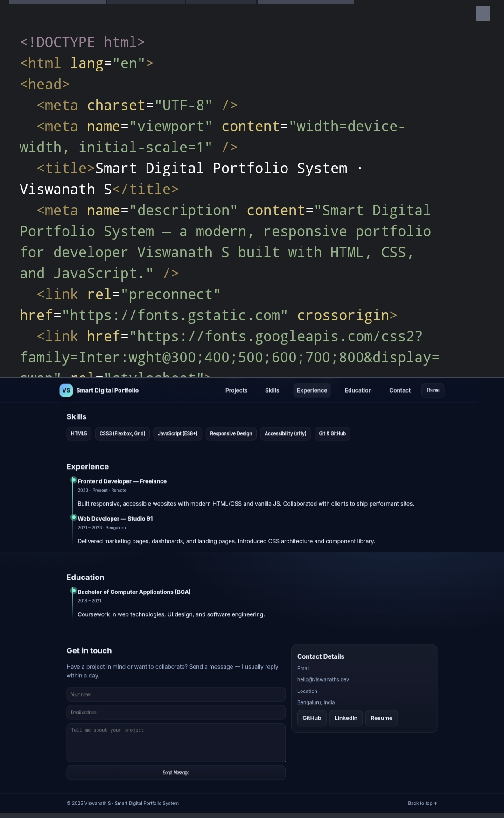
RESULT SCREENSHOT

Slide 14
- Created a centralized platform for student portfolios.
- Helps in career opportunities and academic recognition.
- Future Scope: AI-based portfolio evaluation, recruiter dashboard.
Conclusion:
Conclusion:
- Created a centralized platform for student portfolios.
- Helps in career opportunities and academic recognition.
- Future Scope: AI-based portfolio evaluation, recruiter dashboard.

Slide 15
GITHUB LINK
https://github.com/24bcanm46-commits/VISWANATH-NAANMUTHALVAN-2025.git

